Slide 1
Introducing the terminology
Enterprise software is computer software used to satisfy the needs of an organization.
Martin Fowler: "Enterprise applications are about the display, manipulation, and storage of large amounts of often complex data and the support or automation of business processes with that data."
https://en.wikipedia.org/wiki/Enterprise_software

Slide 2
Example
Right automatization
By Max Dorofeev
https://youtu.be/XDF02KmgJFE?t=1h6m26s

Slide 3
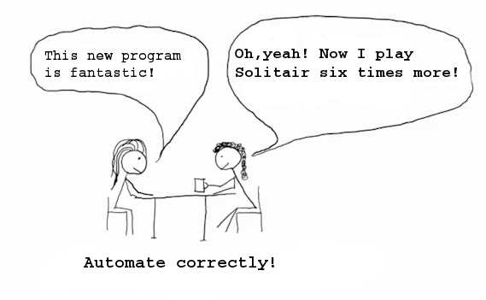

Slide 4
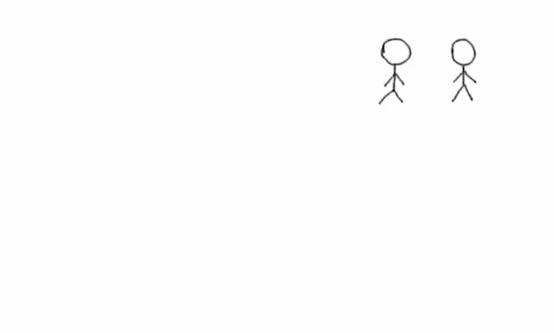

Slide 5
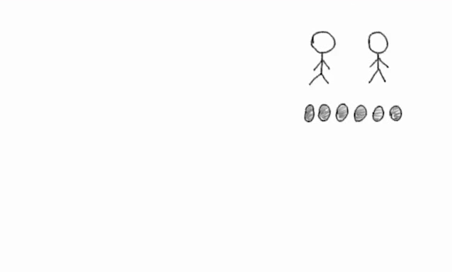

Slide 6
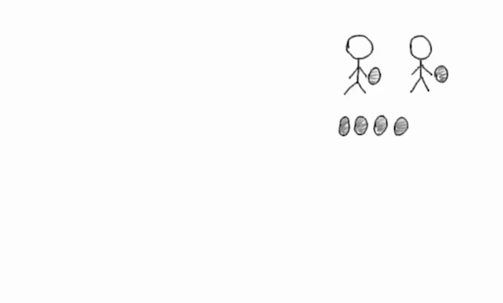

Slide 7
It is necessary to pass report!

Slide 8
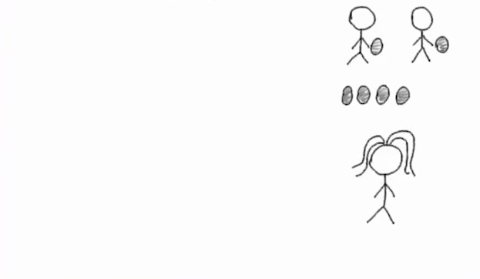
It is necessary to pass report!

Slide 9

It is necessary to pass report!

Slide 10

It is necessary to pass report!

Slide 11
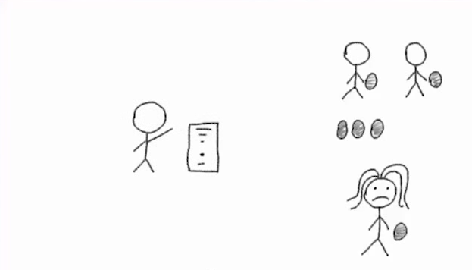
It is necessary to pass report!

Slide 12
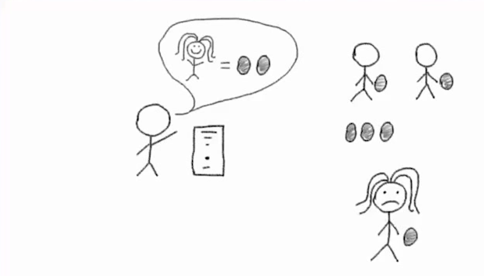
It is necessary to pass report!

Slide 13
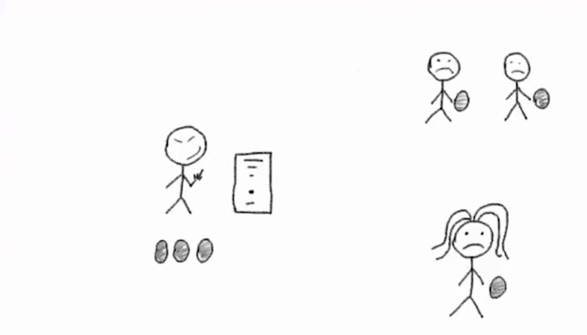
It is necessary to pass report!

Slide 14
Every 4th fails!!!
(* CHAOS report)
It is necessary to pass report!
* https://www.projectsmart.co.uk/white-papers/chaos-report.pdf

Slide 15
Every 4th fails!!!
(* CHAOS report)
It is necessary to pass report!
* https://www.projectsmart.co.uk/white-papers/chaos-report.pdf

Slide 16
It is necessary to pass report!

Slide 17
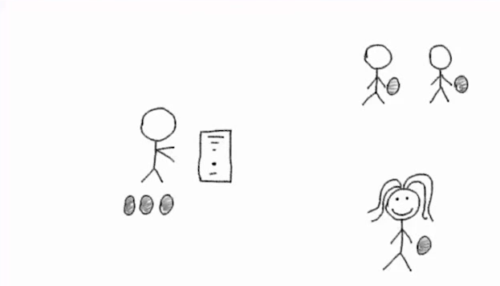
It is necessary to pass report!

Slide 18
It is necessary to pass report!

Slide 19
It is necessary to pass report!

Slide 20

It is necessary to pass report!

Slide 21

It is necessary to pass report!

Slide 22
It is necessary to pass report!
Benefit!

Slide 23
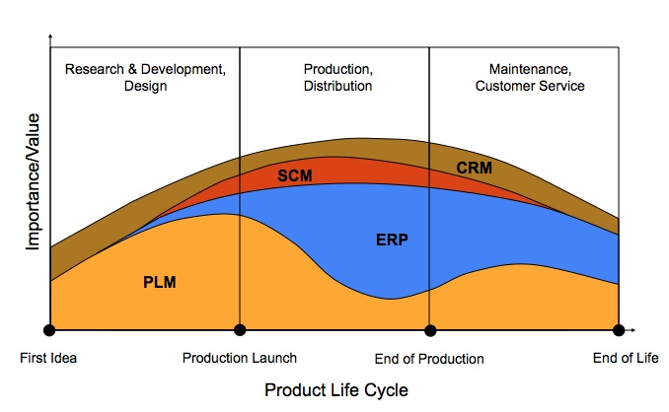

Slide 24

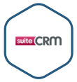





CRM vendors and software, examples
ERPNext
Opensource
https://en.wikipedia.org/wiki/Comparison_of_CRM_systems, https://bitnami.com/stacks/crm

Slide 25





ERP vendors and software, examples
ERPNext
Opensource
https://en.wikipedia.org/wiki/List_of_ERP_software_packages

Slide 26


ECM (enterprise content management)vendors and software, examples
Opensource

Slide 27




PLM vendors and software, examples

